Slide 1
London Ward Analysis
Blanca Huergo

Slide 2
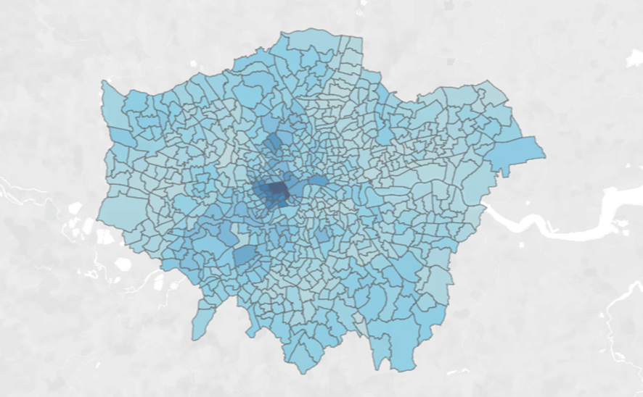
Project Objectives
I will use figures from London to compare setting up businesses in its different wards.
The project aims to cluster London wards to make it easier for businessmen to find the best place to set up.

Slide 3
Data gathered
I collected income data in each ward from the British Government’s website.
I found the coordinates of each ward from GeoPy.
I filled in the location data of the few wards that did not appear on the GeoPy search using the coordinates obtained on latitude.to.
I collected data on the venues available near each ward using the Foursquare API.

Slide 4
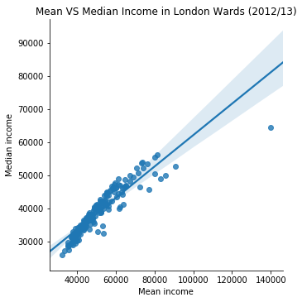
Mean vs median income
The graph on the right clearly shows the trend in the comparison between mean and median incomes in London wards.
For low incomes, the two figures are similar. However, as income increases, the mean becomes higher compared to the median.
This shows I must use both measures to conduct the study.

Slide 5
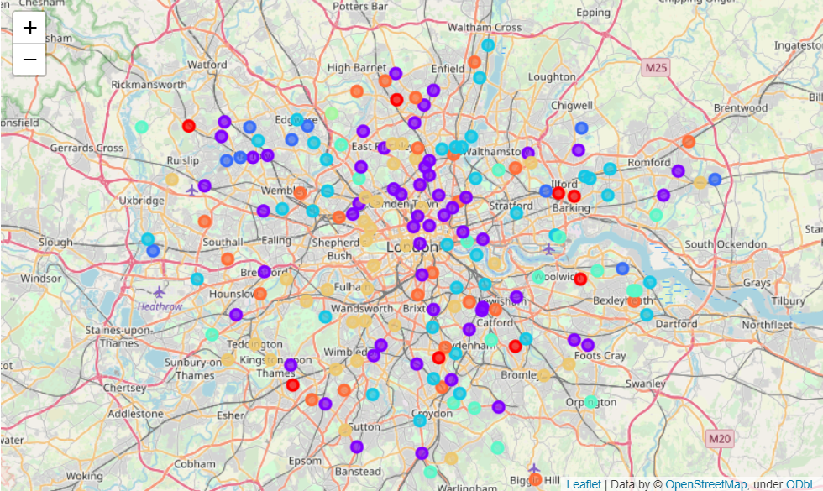
Final Clusters

Slide 6
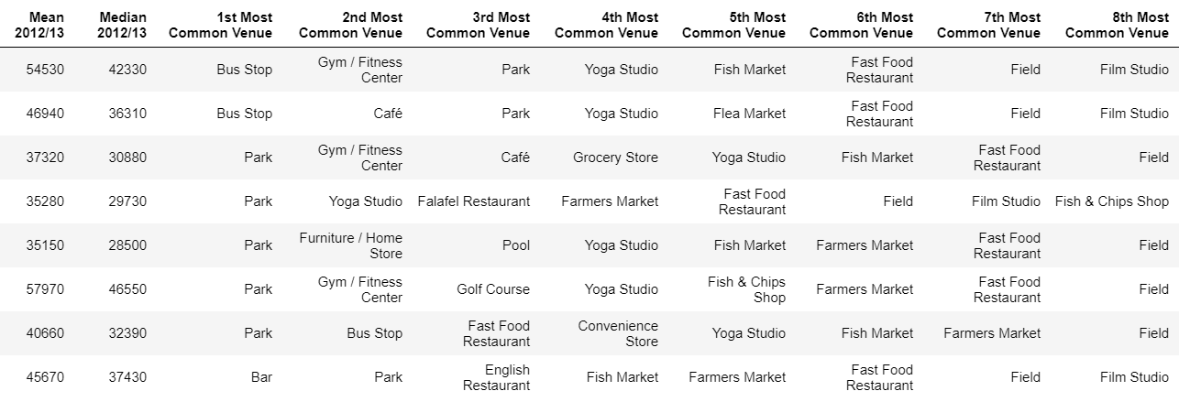
Cluster 1
The neighbours in the first cluster have incomes a bit above the London average (39,100- median and 51,770-mean).
There is a large number of parks, cafés and markets, showing an interest in outdoors activities.
Restaurants are not as common as in other clusters, so businesses set up could focus on outdoors activities, such as sporting events.

Slide 7
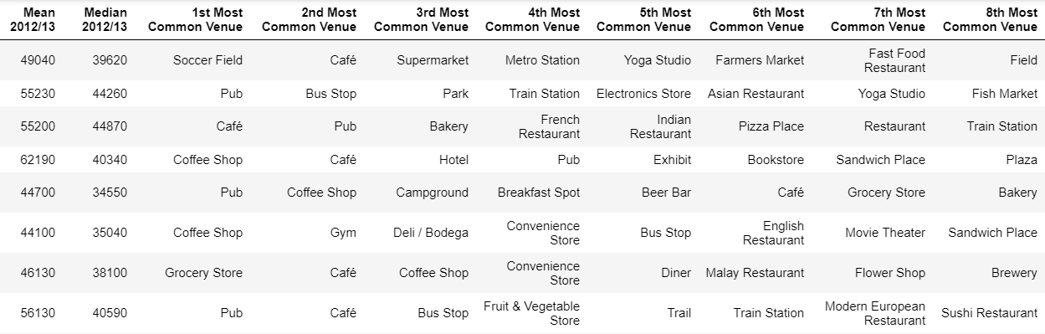
Cluster 2
Neighbours in Cluster 2 have incomes slightly above average.
Restaurants, coffee shops and cafés are common.
Higher prices could be charged here and businesses offering more exclusive or special products could be set up here.

Slide 8
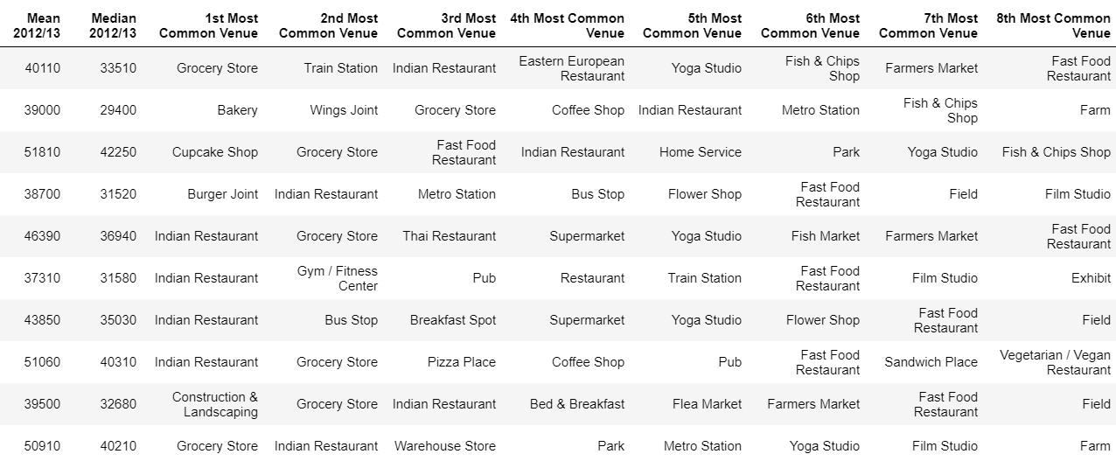
Cluster 3
Neighbours in Cluster 3 have incomes slightly below average for London.
Foreign, presumably cheap restaurants are frequent, as well as fast food and fish and chips.
This shows a preference for simple, cheap ideas, rather than more elaborate ones, which could indicate the trend to follow here.

Slide 9

Cluster 4
Neighbours in Cluster 4 have incomes significantly below the average for London.
However, there is still a lot of activity. There are many pubs, restaurants and sports centres for the neighbours.
This could be an option for a businessman wishing to open a company relating to sport, yet it should be noted that the prices should likely be low for the venue to be successful.

Slide 10

Cluster 5
Citizens in Cluster 5 have median incomes below average yet have quite high mean incomes.
This shows a considerable amount of high-income families and a poor counterpart. Either of these two sectors could be targeted.
There are expensive venues, such as soccer stadiums and gastropubs, as well as cheap ones, such as fish and chips shops and fast food restaurants.

Slide 11
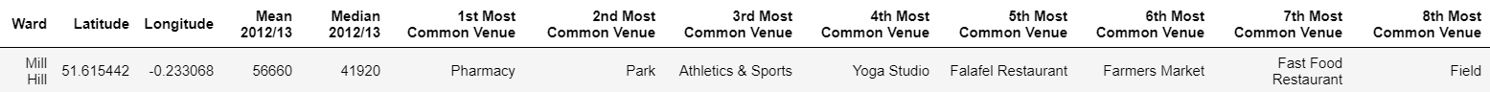
Cluster 6
Cluster 6 is formed by a unique ward: Mill Hill.
Businessmen should study it carefully before setting up there, as the average income is very high and there are a variety of venues already set up.

Slide 12

Cluster 7
The neighbours of Cluster 7 are the ones with the highest average income.
This is reflected in the venues offered, as there are bodegas and Persian restaurants, for example, which are more select than the fast food restaurants offered in other wards.
Cluster 7 is the opportunity for businessmen with more special ideas to succeed, as the high costs of production these usually have can be covered by the high price that can be charged here.

Slide 13
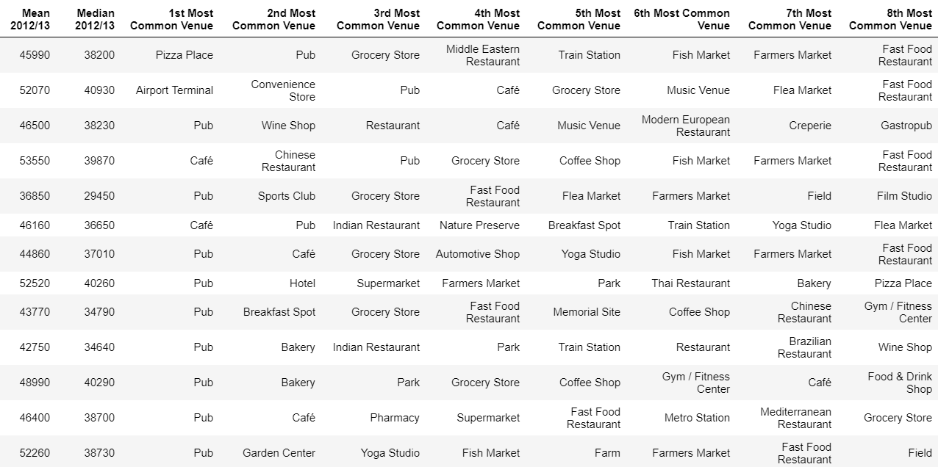
Cluster 8
The neighbours in Cluster 8 have incomes close to the average in London.
Pubs are the most common type of venue in this cluster, as well as a group of culture-related activities, such as memorial sites, nature preserves, wine shops and film studios.
Businessmen in the culture sector, as well as ones looking to set up, could find what they were looking for in Cluster 8.

